Slide 1


2025 - 2026
South Gwinnett High School
Dual Enrollment
Information Session
Co-Dual enrollment counselors
Mrs. Monica Debowles (A-L)
Ms. Tiana Cunningham (M-z)
Subject to Change based on legislative action

Slide 2

What is Dual Enrollment?
An opportunity offered to qualified high school students to earn college credits.
The student is simultaneously enrolled in high school and college and earns credit for both.
The student can be a full-time or part-time college student.
DE is a Big commitment – Choose Wisely!

Slide 3
DE Eligibility to Participate
All 11th -12th grade students attending an eligible public or private high schools or a home student program
No residency or citizenship requirement
Must be admitted to postsecondary institution
Must be on track to graduate high school with class
Cannot be graduated from high school early
Can be denied participation for violation of secondary or post secondary rules
  Example - Failing a course or falling below 2.0 College GPA

Slide 4
DE Eligibility to Participate
House Bill 444
Students will be limited to a total of 30 semester hours
9th grade students are no longer eligible for DE
10th grade REQUIREMENTS
  Meet Zell Miller criteria before DE term
  1200 SAT or 26 ACT
  Min. 3.7 GPA
  11th or 12th graders are eligible
  Meet college acceptance standards
If a student withdraws from a dual credit course, they will not be able to retake that course using state funds.
If a student withdraws from 2 dual credit courses they will be ineligible for further Dual Enrollment funds.

Slide 5
Pros and Cons
Pros
Cons
Immediate college credit
Financial savings for parents and students
  Tuition, Books and most fees are paid
Builds confidence for early college success
Potential earlier college graduation
Extra .05 added to HOPE GPA
Students may take up to 15 college hours p/semester (5 college courses)
Students must keep up with important Junior/Senior High School information
Some colleges prefer AP or IB courses over DE courses
Colleges will not communicate with parents regarding student grades, attendance, etc.-unless student provides written consent – through college account.

Slide 6
Is Dual Enrollment Right
For You?
Ready
Maybe Not Yet
Organized
Proactive
Flexible
Able to handle Stress
Assertive
Able to Self-Advocate
Independent
Check Your Emails
Meet deadlines
Good grades already
Unorganized
Procrastinator
Easily Overwhelmed
Passive
Scared to Ask for Help
Highly dependent on Others
Ignore Emails & Messages
Need extra time to turn in assignments

Slide 7
Should I Take AP or DE?
AP
Dual Enrollment
Depends on where you want to go to college.
Highly competitive schools view AP courses as the most rigorous level at the high school.
Nationally accepted as being rigorous.
Must get a certain score on the AP exam to get college credit
Excellent if you plan on attending a college in the University System of Georgia.
Accepted as being rigorous.
Must get a “C” in the class to receive credit

Slide 8
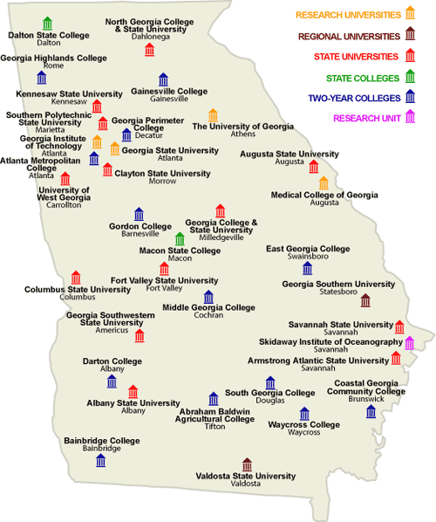
Where Can I Attend?
A student may apply to attend any participating public college, private college or technical college in Georgia.

Slide 9


Most students at South apply to Georgia Gwinnett College(GGC) or Gwinnett Technical College(GTC).
http://www.ggc.edu/admissions/admissions-requirements/dual-enrollment/
https://www.gwinnetttech.edu/dualenrollment/

Slide 10
Georgia Gwinnett College
DE Basic Eligibility:
Gwinnett Tech.
DE Basic Eligibility
11th and 12th Graders Only
Must be 16y/o to attend
GPA: 3.25 Core (HOPE Eligible)
SAT: 26 Reading 500 Math
ACT: 21 English and 19 math; Composite 20
Submit Free online application
10th - 12th Graders
2.6+ Core Recommended
Accuplacer Test, ACT or SAT Accepted
  Score requirements determined by program area (see GTC website)

Slide 11
Levels Of The Program
Full-Time
Part-Time
Attend classes at the college full-time
Must take at least 4 classes at the college
May take up to 15 college hours p/sem.
Still considered a South student
Must earn 2.5 credits p/sem. to be eligible for South athletics
Combination of classes at South and the college of your choice
Based on 7 Period Day!
Student schedule should reflect 6 segments.
  3 DE + 3HS
  2 DE + 4 HS
  1 DE + 5 HS
  4 DE + 0 HS

Slide 12
South Gwinnett
Campus Options
On Campus
Off Campus
Fall 2024
ENG1101 (Adv. Comp.)
  80% pass in 10th Lit
  MATH 1111 (College Algebra)
Spring 2025
ENG1102 (Brit. Lit.)
  “C” in ENG1101
  MATH 1127 (Intro. To Statistics)
All Semesters 2025 - 2026
GTC Online
  80% pass in content area
GTC – Lawrenceville Campus
  80% pass in content area
GGC – Lawrenceville Campus
Any Other Post-secondary Institutions: Ex:
  GA State – Clarkston
  GA State – downtown Atlanta

Slide 13

Will My Credits Transfer?
It is the student’s responsibility to talk with colleges regarding their policies on Dual Enrollment credit.
Generally, public colleges in Georgia will honor any credit earned at any Technical or other Public college in Georgia when grade is “C” or better.
Private colleges and out of state colleges vary on their acceptance of DE credits.

Slide 14
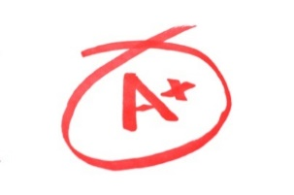
What About Grading?
Most colleges will send letter grades which will be transcribed as: A=95, B=85, C=75, D=70, F=55
3-5 semester hour college classes = 1.0 HS credit
No points are added to the final grade, but students receive an additional .5 to their core HOPE GPA on a 4.0 scale.
No End of Course Tests required for DE courses.
If the student fails a college class, it could jeopardize graduation and their HOPE scholarship eligibility.
ALL DE classes are included on high school transcript
Important Notes:
College Science labs will not receive HS credit but will be recorded on College transcript.
Labs will not count toward fourth science requirement.
HS seniors are eligible to take DE courses during Fall and Spring semesters, but not the summer of their graduating year.

Slide 15
Course Basics
Math:
Alg: Con & Conn, Geom: Con & Conn, Adv. Alg: Con & Conn or higher must be taken at the high school before any college Math courses will be approved.
Science:
College Biology I or Chemistry I CANNOT count as 4th Science for graduation. College Pre-Calculus is required before Physics can be taken at college.
English
If 11th American Lit. is not taken at South, English 1101, English 1102, AND College American Lit. must be taken to get credit for HS credit.
History:
U.S. Hist. 2111 or US Hist. 2112 will meet the graduation requirement.
  Macro or Micro Econ. will meet the graduation requirement.

Slide 16

Dropping or Changing Courses
Any college course changes made at the beginning of the semester must be approved by the DE Counselor.
Dropping college classes AFTER the college’s Drop/Add period at the beginning of the semester is Not an Option.
Colleges will advertise Drop/Add timeframes.
  These are for current college students, not DE students.
Dropping courses could result in DE courses being unavailable the following semester.
Student’s graduation status could be affected if courses are dropped or changed without approval.

Slide 17

Dual Enrollment Galore
AT:
https://www.gafutures.org/
Create or Update Your Gafutures Account

Slide 18
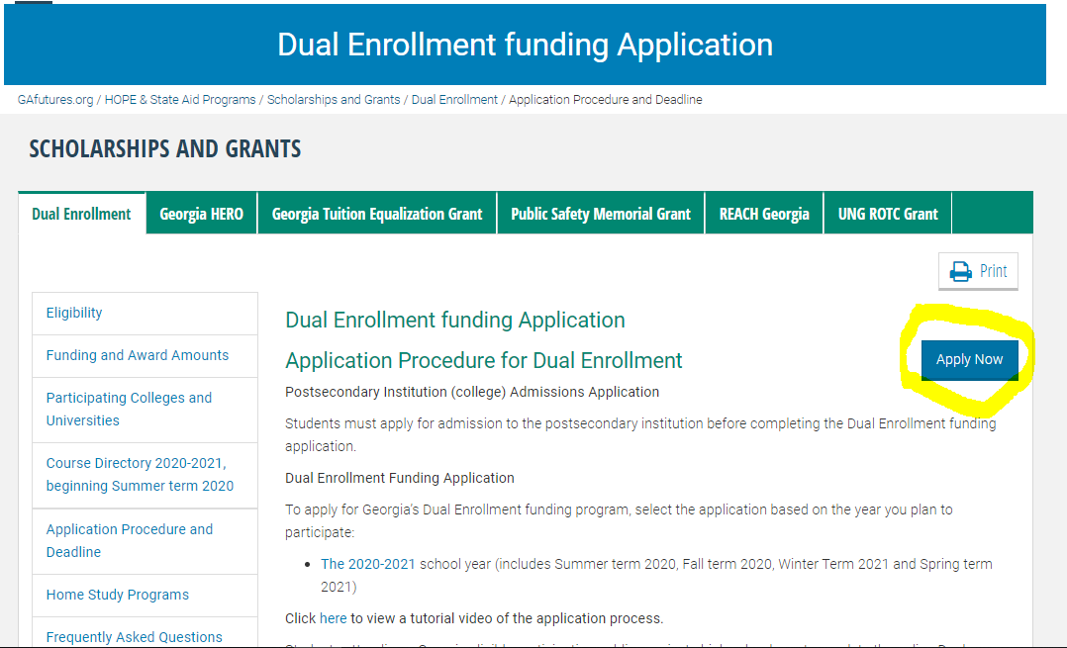
View The DE Application Process on Gafutures.org
https://www.gafutures.org/hope-state-aid-programs/.../dual-enrollment/
Dual Enrollment Funding Application must be completed once a year.**

Slide 19
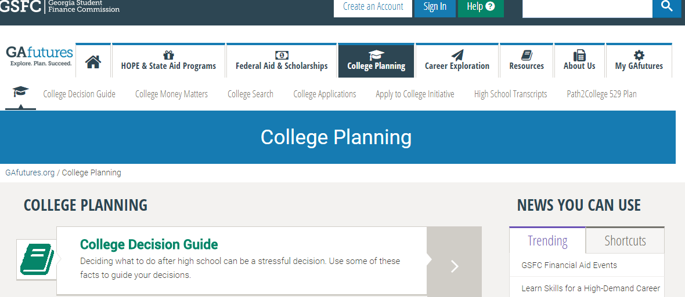
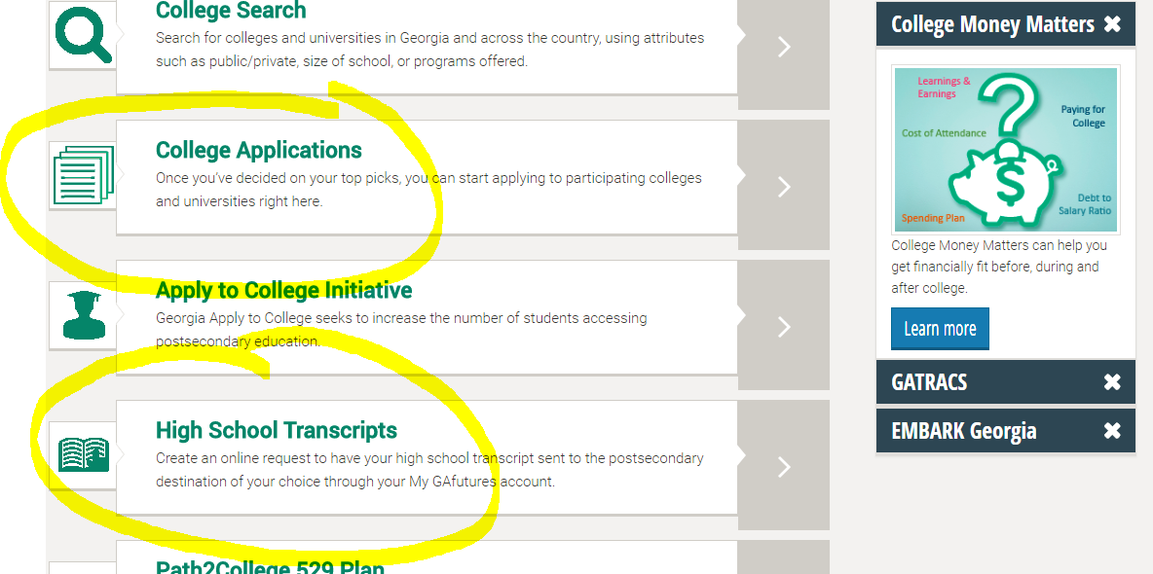
GAFutures….. Applications & Transcripts
The College Applications Link can be used to apply to some schools for DE. Many programs require students to use the college’s website to apply.
Sending transcripts can be done quickly and easily through the High School Transcripts link.

Slide 20
2025 – 2026 South Gwinnett HS
DE Procedures
  For Step-By-Step Directions to Apply for Dual Enrollment through South Gwinnett High School
  Go to SGHS Website
  Go under Counseling tab
  Click on Dual Enrollment tab
  College deadlines will be different from our high school deadlines. Students must meet South Gwinnett HS deadlines to participate in the DE Program.
  South Gwinnett HS Dual Enrollment Deadline is May 2, 2025

Slide 21

Final Considerations
College classes should be planned around South’s schedule
  Ex. If Part-Time, choose college course times AFTER 5th PERIOD (12:30PM)
DE is Free – But, some course specific fees must be paid by the student including any Late fees
Colleges communicate with the Student through email -Not the parent/guardian or South
Competitive colleges may not consider DE courses as rigorous as AP courses offered at South
Student must have all schedule changes approved by the South DE counselor
Student should check South website to keep up with important announcements and activities-especially Seniors!
Student services (IEP, 504 plans, etc.) must be arranged with the college by the student

Slide 22
Final Considerations
Credit transferability is Not guaranteed
College Holidays, Spring Breaks may be different from South’s
Students are not allowed to be on South’s campus on days or periods they don’t have classes at South
Students are not allowed to be at South if they are taking college Online courses-Media Center is not an option
  If you are not able to leave South during your assigned DE courses, you will need to reconsider participating in the program.
DE Coordinator must receive college schedule from Student, before South Schedule will be changed
DE is a big commitment – choose wisely!!

Slide 23
South Gwinnett High School
Dual Enrollment Coordinators
Mrs. Monica DeBowles
Dual Enrollment Coordinator for Last Names A – L
Monica.debowles@gcpsk12.org
(770) 736 – 4313
Ms. Tiana Cunningham
Dual Enrollment Coordinator for Last Names M – Z
Tiana.Cunningham@gcpsk12.org
(678) 344 - 2160

